Slide 1
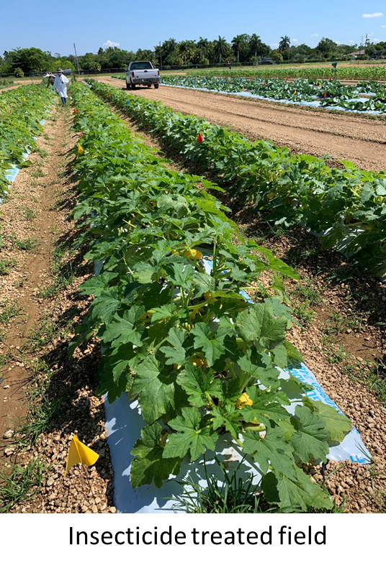
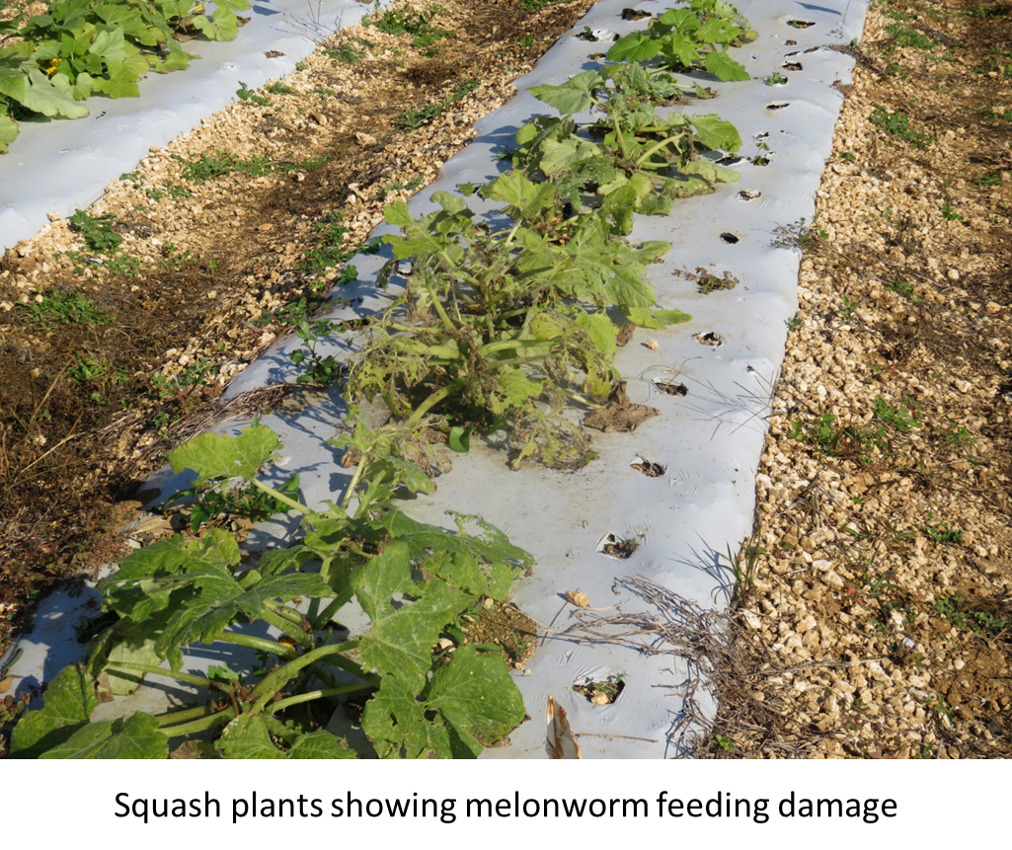
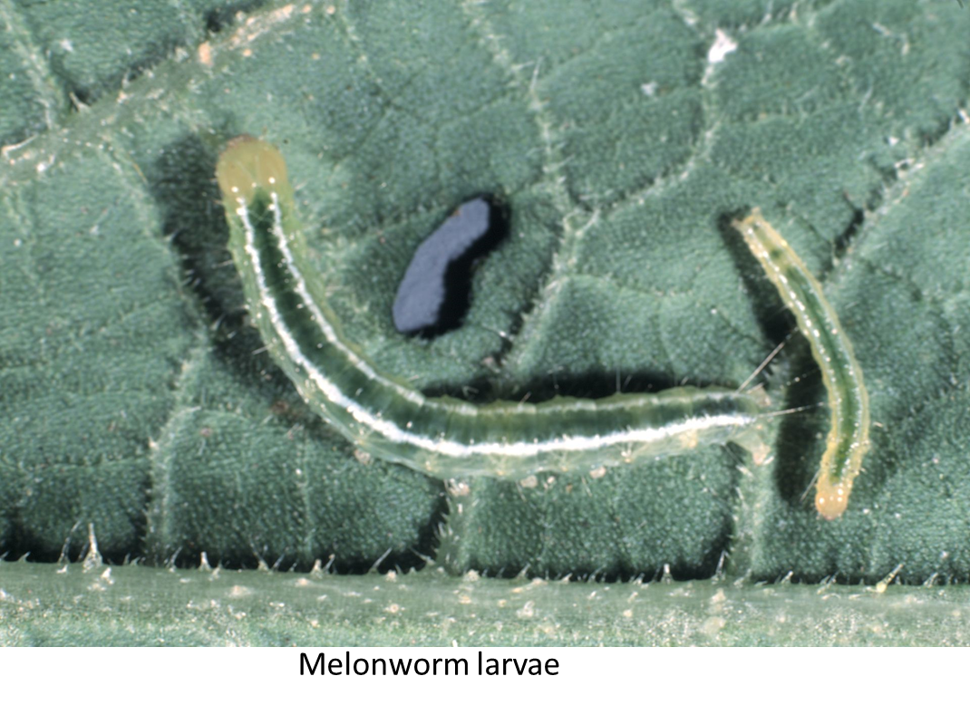
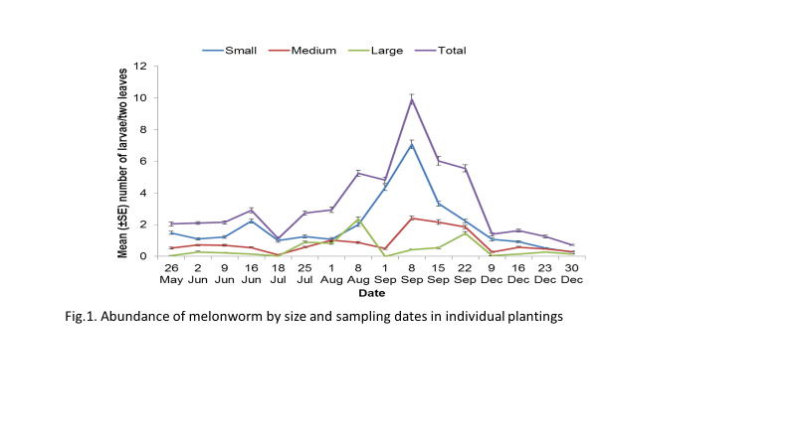
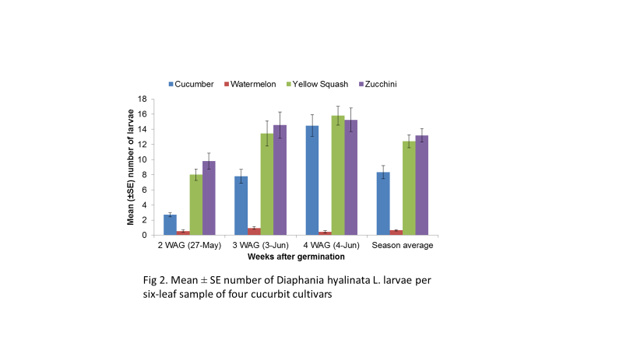
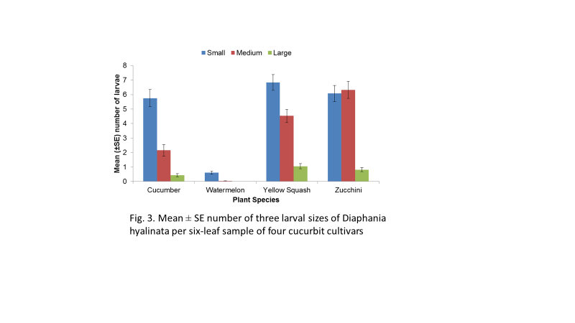
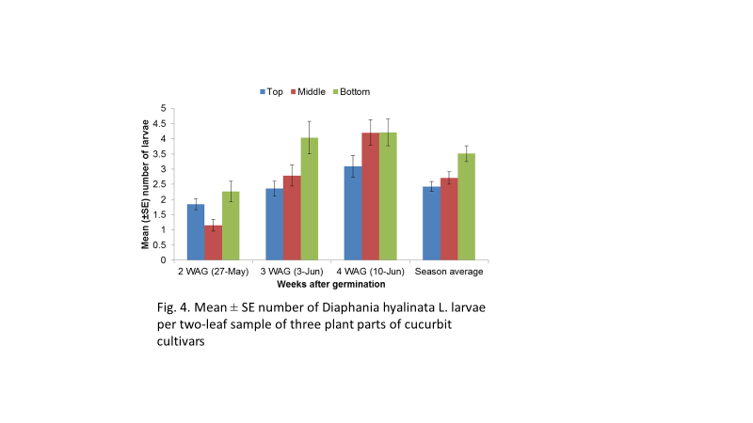
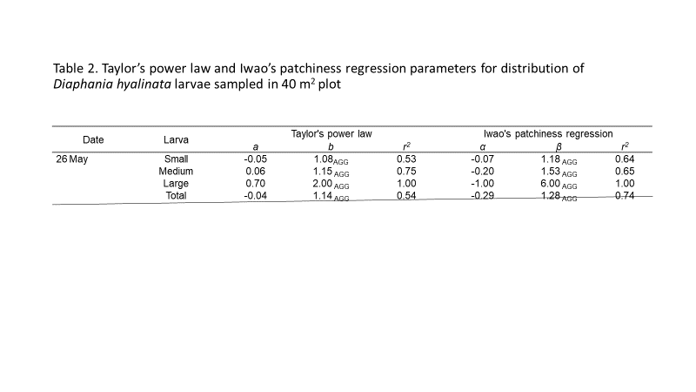
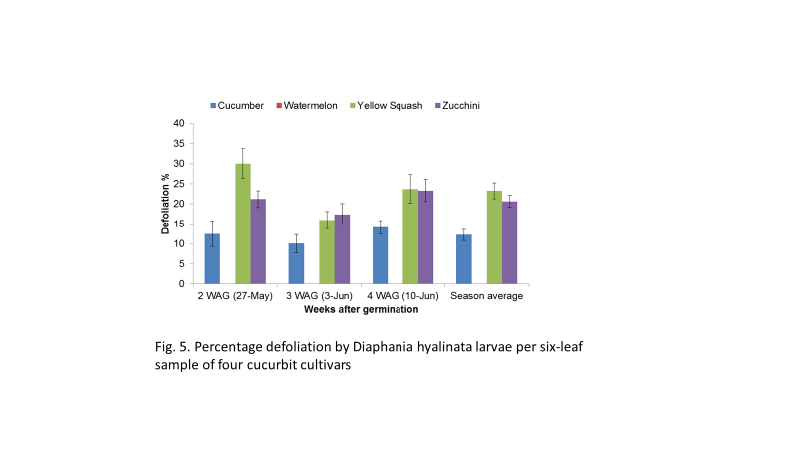
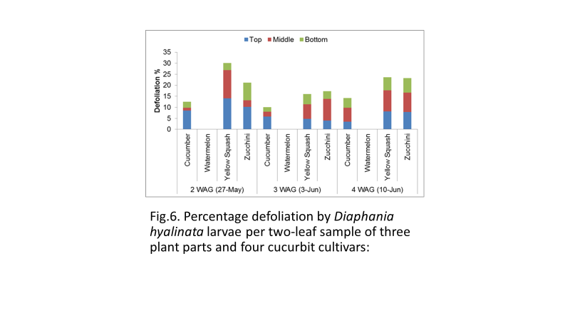


POPULATION DYNAMICS AND MANAGEMENT OF MELONWORM IN SOUTH FLORIDA
D. R. Seal and B.R. Panthi, ¹University of Florida-IFAS, Tropical Research and Education Center, Homestead, FL, USA
Abstract. Melonworm, D. hyalinata L., is a serious foliage-feeding pest of cucurbits, which causes huge annual economic losses to cucurbit crops. Population density is high in August and September with the highest peak in September. Density remains low before and after this time. The density of small larvae is always greater than the medium and large larvae. Population abundance is high in yellow squash and Zucchini followed by cucumber and watermelon. Larvae abundance was always high on the bottom leaf followed by middle and top leaf. The larval feeding was high on yellow squash followed by zucchini and cucumber. Watermelon did not sustain any discernible feeding damage. Melonworm larvae showed aggregated pattern of distribution during all months of this study.
Introduction
Cucurbit crops are widely grown in the USA, with a production of about 3.9 million metric tons on 157,370 hectares, and a value of $1.53 billion. Florida has been the leader in fresh-market production of cucumber, squash, and watermelon, which contribute nearly $247 million to the Florida economy (USDA 2014)
The melonworm is a serious pest of Cucurbitaceae throughout the southeastern United States (Fulton 1947, Dupree et. al. 1955). The adult moth is active throughout the winter months in southern Florida and disperses throughout the southern and gulf coast states every summer (Reid et al. 1954, Reid & Cuthbert 1956). During the summer, melonworm also migrates into the Carolinas, Oklahoma, Nebraska, and other more northern states (Zehnder 2011).
Melonworm can feed throughout cucurbit plants causing primary and secondary damages resulting in yield reduction (Guillaume and Boissot 2001, Valles and Capinera 1992). Third through fifth instar melonworm larvae feed voraciously on the whole plant including fruit, leaves, and stalks; often removing leaf material while leaving veins and veinlets intact (Valles and Capinera 1992). Melonworms feed mostly on leaves, however, once the leaf supply is exhausted, larvae begin to feed on the fruit surfaces, or even bore into the fruit (Capinera 2005). Severe infestation by melonworms may result in total crop failure, leaving only skeletonized remains of plants. Squash and cucumber are, in general, more severely affected by melonworms than watermelon and pumpkins (Zehnder 2011). Melonworm foliage-feeding results in indirect yield reductions of about 9 to 10% (McSorley and Waddill 1982). In some instances, when infestation occurs at an early stage of its host crops, melonworm feeding on foliage may cause >70% yield loss in cucumber. In Florida, further decreases in yields (about 23%) have been noted from melonworm causing direct losses by feeding on flowers and fruit. In south and central Florida, the common cucurbit weeds creeping cucumber, Melothria pendula L., and wild balsam apple, Momordica charantia L., serve as wild hosts of melonworm (Elsey et al. 1985).
Results and discussion
Abundance of melonworm by size and sampling dates in individual plantings. During the first crop planting season between 26 May to 16 June, the number of larvae was low (2.04 ± 0.13 larvae per two leaves; ± SE) on 26 May, two weeks after germination (Fig. 1). Population gradually increased with time and was found to be significantly greater (2.91 ± 0.16 larvae/two leaves ± SE) on 16 June, five weeks after germination. A similar pattern of larvae abundance was recorded during the 2nd planting (18 July – 8 August), 3rd planting (1 September to 22 September) and 4th planting (9 to 30 December). The highest peak of larval population was recorded in the middle of the 3rd planting. Irrespective of any planting season, the mean number of small larvae (1st-2nd instar) was higher than the medium (3rd-4th instar) and large larvae (5th instar). This decrease in the number of larvae with the progression of development was due to the natural mortality factor.
Abundance of various size groups. When cultivars were considered, the mean number of all sizes larvae were higher in yellow squash and zucchini followed by cucumber (Fig. 2). The mean number of small larvae was higher than other size groups, except in zucchini where medium size larvae were numerically higher than the small size (Fig. 3). In watermelon, we recorded only small size larvae which eventually died out before developing into the next stage.
Within-plant distribution. We divided each plant into three parts- top, middle, and bottom. The highest number of melonworm larvae were recorded on the bottom part followed by the middle and top part (Fig. 4). This pattern of abundance of larvae was recorded on all sampling dates (2, 3 & 4 WAG). When means of each size group were averaged across the season, the pattern of abundance remained similar.
Percentage defoliation. Yellow squash suffered the highest percentage defoliation followed by zucchini and cucumber on all sampling dates of 2, 3 & 4 WAG (Fig. 5). Watermelon did not suffer any feeding damage due to the high mortality factor at the first instar.
Highest percentage defoliation was recorded on the middle part of plants followed by top and bottom parts irrespective of cultivar type (Fig. 6). Defoliation was absent on watermelon.
Spatial distribution of melonworm. We used 40 m² plots to determine distribution pattern using Taylor’s power law and Iwao’s patchiness regression. Based on the two statistics, distribution pattern was aggregated in 92% instances (Fig. 7).
Materials and Methods
Seasonal abundance. All studies were conducted at the Tropical Research and Education Center (TREC), Homestead, FL, under field conditions using four plantings of yellow squash set at different sites. Preparation of soil and all cultural practices to manage crops followed standard methods as discussed in Vegetable Production Handbook of Florida (Freeman et al. 2016). To study melonworm abundance in different seasons, crops were planted four times in a year. Abundance of melonworm was studied separately in each of four plantings to understand the time of their optimum population increase in each planting. To obtain information on population abundance, sampling for melonworm was initiated two weeks and five weeks after germination of yellow squash plants in each planting. Five plants per plot were randomly selected and two leaves from each plant (10 leaves per plot) were collected. The larvae were separated from the leaf samples and visually graded as small (1st & 2nd instar), medium (3rd-4th instar) and large (5th instar) size.
.

