Slide 1
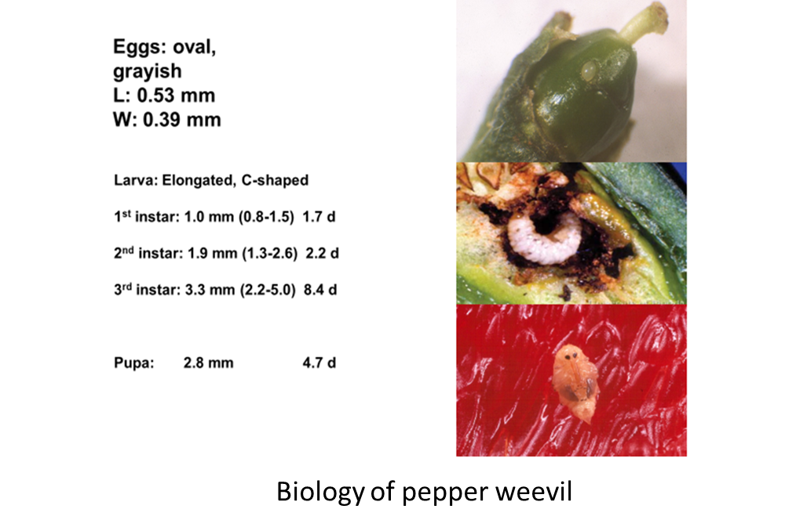
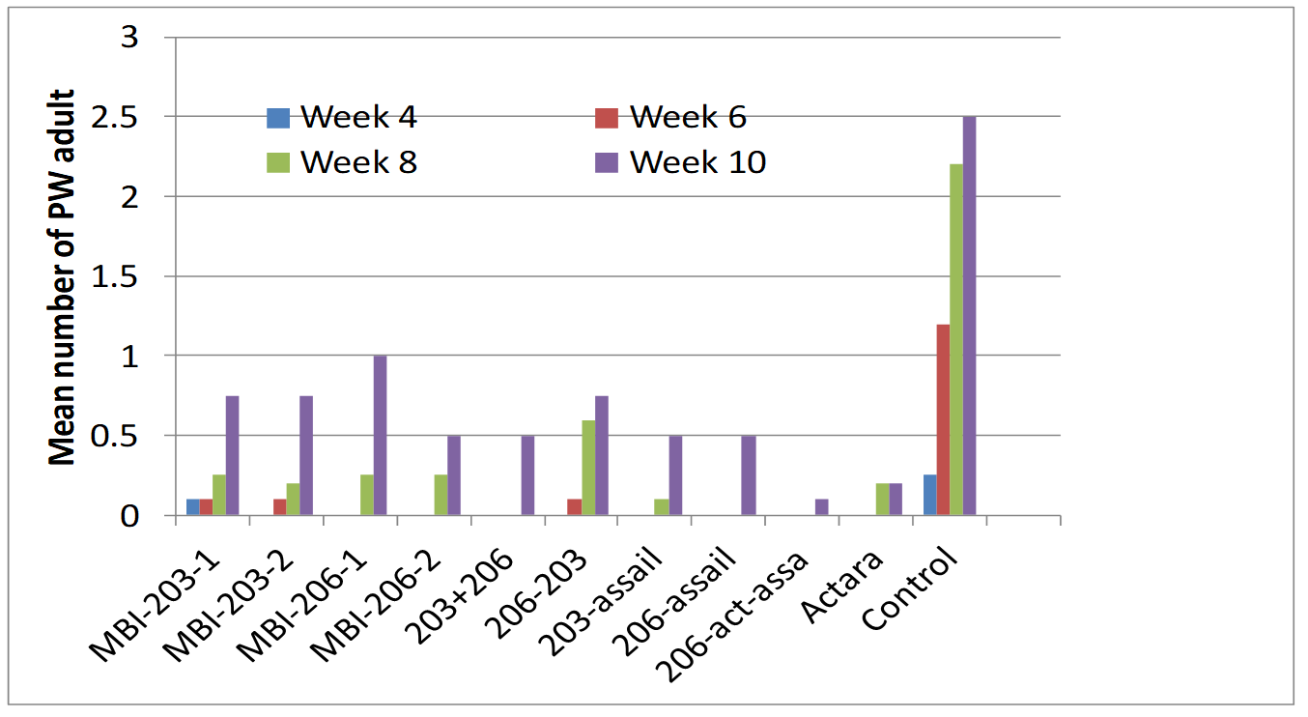
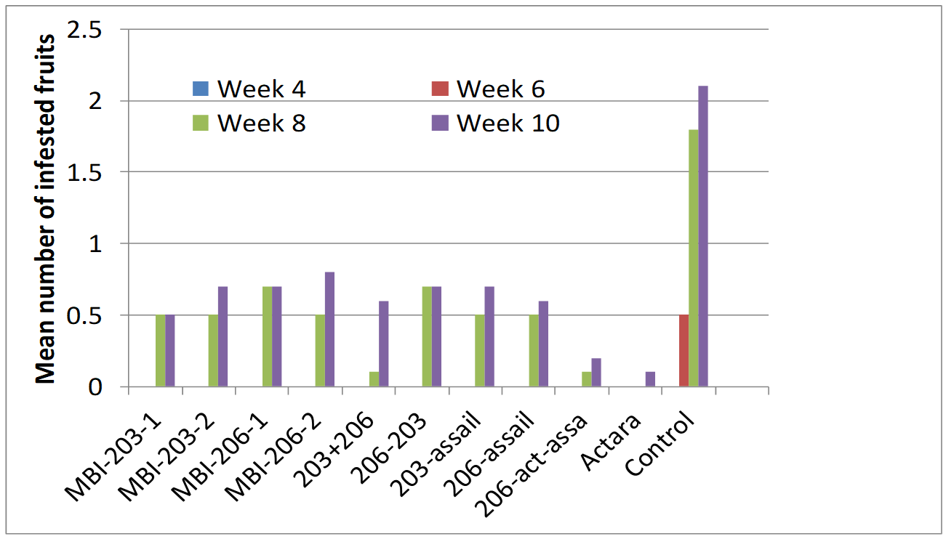
Control of pepper weevil, Anthonomus eugenii Cano (Coleoptera: Curculionidae) using biological, cultural and chemical practices
Dakshina R. Seal, Victoria O. Adeleye and Catherine Sabines University of Florida-IFAS, Tropical Research and Education Center, Homestead, FL 33031
Abstract. Experiments were conducted to evaluate the effectiveness of various biological, chemical, and cultural techniques in managing pepper weevil (PW), Anthonomus eugenii Cano. Catolaccus hunteri Crawford is a native parasitoid and shows effectiveness in suppressing pepper weevil when applied in high density. Companion crops (nightshade, cowpea and eggplant) alone did not reduce abundance of pw on pepper. Among insecticides, thiamethoxam and oxamyl were effective in managing pepper weevil. Biological insecticides Chromobacterium substufae (Strain PRAA4-IT) (MBI 203) and Burkholderia sp. (MBI-206) are active against insects upon ingestion. Biological insecticides provided significant reduction of PW when used in combination with thiamethoxam and acetamiprid. Use of reflective mulch as a bed cover provided significant reduction of pepper weevil.
Introduction. The pepper weevil (PW), Anthonomus eugenii Cano, is the most insidious biotic constraint on the production of various types of pepper, (Capsicum annuum L.) in Florida, California, Texas, Mexico, Central America, and the Caribbean (Burke and Woodruff 1980, Patrock et al. 1992, Patrock and Schuster 1987). Feeding by larvae and adults causes severe losses in both yield and fruit quality (Elmore et al. 1934, Schuster and Everett 1982). Campbell (1924) found up to 100% infestation of young pepper in commercial fields. Infested flowers and fruits are abscised and drop to the ground (Riley 1990, Seal and Schuster 1995, Adeleye et a; 2021). Moreover, high PW infestations have been observed to defoliate pepper plants and to prevent fruiting (Rolston, 1977).
Currently pepper growers use oxamyl (Vydate) and thiamethoxam to combat PW. Frequent use of these insecticides may cause development of resistance in PW. In the present study, we investigated potentiality of biocontrol agent, biological insecticides, and cultural control methods in managing PW in pepper fields
Results and Discussion.
Biocontrol agent (Catalaccus hunteri). On the first sampling date, two weeks after the first release of C. hurnteri, treatment having 40 adults/release/plot did not differ from treatments 10 and 20 adults/release (Table 2). However, all treatments (10, 20 & 40 adults/release) significantly reduced PW infested fruits as compared to the untreated control. Similar pattern of PW infested fruits reduction was recorded on the subsequent sampling dates with the higher number of adults (20 & 20) showing better reduction than 10 adults/per release.
Companion crops. On the first sampling date, we did not collect any PW infested fruits (Table3). On the second sampling date, eggplant treated plots had significantly fewer PW infested fruits than the untreated control. On the subsequent sampling dates, companion crops association did not reduce PW infested fruits as compared to the untreated control. The highest reduction of PW infested fruits was recorded in thiamethoxam treated plots followed by C. hunteri plots.
Effectiveness of biological and conventional insecticides. In the present study, bacterial insecticides significantly reduced PW adults on all sampling dates (Fig. 1). MBI-203 did not differ among experimental rates in reducing PW adults. On the other hand, MBI-206 provided better reduction of PW adults. MBI-203 at 2 lbs./acre rotated with Assail significantly reduced PW adults. Similar result was observed when MBI-206 was rotated with Assail. Thiamethoxam alone or in rotation with MBI products and acetamiprid provided superior reduction of PW adults when compared with the nontreated control.
All bacterial insecticides significantly reduced PW infested fallen fruits (Fig. 2). Thiamethoxam alone or in rotation with MBI products and acetamiprid provided superior reduction of PW infested fruits.
Combined effect of mulch and insecticides. On the no mulch block, insecticide treatments did not differ from the untreated control in the mean number of PW adults (Fig. 3). On the mulched blocks, insecticide treatments significantly reduced PW adults as compared to the untreated control. Overall, reflective silver on white mulch had fewer PW adults than the non-reflective white on black mulch.
On the no mulched block, insecticide treatments significantly reduced mean number of PW infested fruits as compared to the untreated control (Fig. 4). On the white on black mulch, imidacloprid treated plants had significantly fewer infested fruits than the control. On the reflective mulch block, overall infested fruits were fewer than the no-mulched and white on black plastic mulch blocks. Mean number of infested fruits on insecticide treated plots did not differ from the untreated control plot.
Materials and Methods. The study was were set 12 March 2021,12 inches apart on 8 conducted in University of Florida-IFAS, Tropical Research and Education Center (TREC), Homestead, Florida.
Biocontrol agent (C. hunteri). Koppert Biological provided C. hunteri. Different densities used in this study included 10, 20 and 40 adults/plot. Adults were released weekly. Evaluation was made by collecting pepper weevil (PW) infested fruits.
Companion crops. Various non-host plants used in association with `Jalapeno’ plants included Nightshade, Cowpea, Eggplant to repel or confuse pepper weevil adults in finding pepper. We compared the performance of non-host plant treatments with thiamethoxam and biocontrol agent C. hunteri. Evaluation of treatments was made by counting PW infested fruits.
Effectiveness of biological and conventional insecticides. Effectiveness of insecticides were conducted in Tropical Research and Education Center research plots in Homestead, Florida. Transplants of `Jalapeno’ pepper inches high and 32 inches wide beds of Rockdale soil. Various treatments used in this study are shown in Table 1.
Application of all treatments was initiated three weeks after planting. Treatments were applied once a week for four weeks using a backpack sprayer delivering 50 gallons per acre at 30 psi Evaluation of insecticides was made 48 h after each application by thoroughly checking five plants per treatment plot for PW adults. PW infested fruits and flowers were also collected at the time of checking plants.
Combined effect of mulch and insecticides. The experimental design was a split-plot with four replications dusing mulch treatments as the main plot, and insecticide treatments as the sub-plot. The mulch treatments were: Metalized top and white bottom, white on black and bare soil with no mulch as an untreated control. The insecticide treatments (subplots) evaluated were: thiamethoxam (Actara®), oxamyl (Vydate®), and untreated control. Evaluation of plastic mulch and insecticide treatments was made by visually checking five random plants per treatment plot thoroughly for pepper weevil adults and infested fallen fruits 24 h after each spray application. Data were analyzed using a mixed model ANOVA (PROC GLIMMIX model, SAS) with the fixed effect consisting of plastic mulch, insecticide treatments and their interactions on the response variables.
Treatment (# C. hunteri adults) | Jan 15b | Feb 19 | Mar 12 | Mar 26 | Apr 30
10 | 0.6 ± 0.6b | 6.6 ± 1.2b | 2.3 ± 1.8b | 5.0 ± 2.0a | 2.0 0.5b
20 | 0.6 ± 0.3b | 10.6 ± 1.7a | 0.6 ± 0.6c | 3.3 ± 1.7ab | 0.6 ± 0.3c
40 | 0.3 ± 0.3 b | 0.6 ± 0.6c | 1.0 ± 1.0bc | 3.0 ± 0.5b | 0.3 ± 0.3c
Control | 4.3 ± 3.8a | 0c | 5.6 ± 2.3a | 4.3 ± 2.1a | 4.0 ± 1.0a
A
A
A
A
B
B
Means within a column followed by the same letter do not differ significantly (P < 0.05; Proc Glimmix)
Fig. 1. Effectiveness of various bio-insecticide treatments in
suppressing pepper weevil adults
Table 3. PW infested fruits in different management programs
A
Treatment | Apr 20 | May 5 | May 13 | May 20 | May 27 | June 6
Catolaccus | 0 | 2.7±1.2ab | 16.7±4.3a | 15.7±6.6b | 23.2±4.9b | 27.0±2.3ab
Actara | 0 | 1.7±0.8b | 10.5±2.5b | 7.0±4.6c | 8.2±9.0c | 5.2±21.7c
Nightshade | 0 | 3.5±1.0ab | 11.5±4.0a | 19.7±3.4ab | 31.0±3.9ab | 20.2±2.ab
Cowpea | 0 | 4.5±2.8a | 24.7±4.0a | 24.7±2.3a | 44.0±5.0a | 32.5±8.7a
Eggplant | 0 | 1.5±0.8b | 22.3±4.5a | 30.2±7.7a | 45.7±8.5a | 40.2±8.0a
Control | 0 | 4.0±1.4a | 19.0±7.2a | 24.2±8.1a | 46.0±17.8a | 37.2±9.4a
F2,270=13.28, P<0.0001
A
F2,270=3.45, P=0.03
B
B
B
AB
Means within a column followed by the same letter or no letter do not differ significantly (P < 0.05; Proc Glimmix)
Fig. 2. Effectiveness of various bio-insecticide treatments in
suppressing pepper weevil infested fruits
Literature cited
Fig. 4. Combined effect of plastic mulch and insecticides on the mean number of fallen infested fruits, Fall 2020
Burke, H.R. and R.E. Woodruff. 1980 The pepper weevil, Anthonomus eugenii Cano in Florida (Coleoptera: Curculionidae). Fla. Dept. Agr. Consumer Serv. Entomol. Cir. 219, 4 pp.
Patrock, R. J. and D.J. Schuster. 1987. Field survey for the pepper weevil, Anthonomus eugenii, on nightshade. Proc. Fla. State Hort. Soc. 100:217-220.
Elmore, J.C., A.C. Davis and R.E. Campbell. 1934. The pepper weevil. U.S. Dept. Agr. Tech. Bull. 447, 27pp.
Schuster, D.J. and P.H. Everett. 1982. Control of the beet armyworm and pepper weevil on pepper. Proc. Fla. State Hort. Soc. 95: 349-351.
Riley, D.J. 1990. Refined sampling methodology and action thresholds for the pepper weevil, Anthonomus eugenii Cano (Coleoptera: Curculionidae). Ph. D. Dissertation, University of Florida, Gainesville, FL. ,
Seal, D.R. and D.J. Schuster. 1995. Control of pepper weevil, Anthonomus eugenii in west-central and south Florida. Proc. Fla. State Hort. Soc. 108: 220-225.
Rolston, L.H. 1977. Insecticide tests in laboratory and field against the pepper weevil, Anthonomus eugenii Cano. J. Ga. Entomol. Soc. 12: 117-120.

