Slide 1

Management of Vegetable Insect Pests, 2023
TREC, UF-IFAS
Homestead, FL. 33031
Dak Seal, Cathie Sabines, Sumit Jangra, Victoria Adeley, Nagamani Kanchupati and Charles Carter

Slide 2
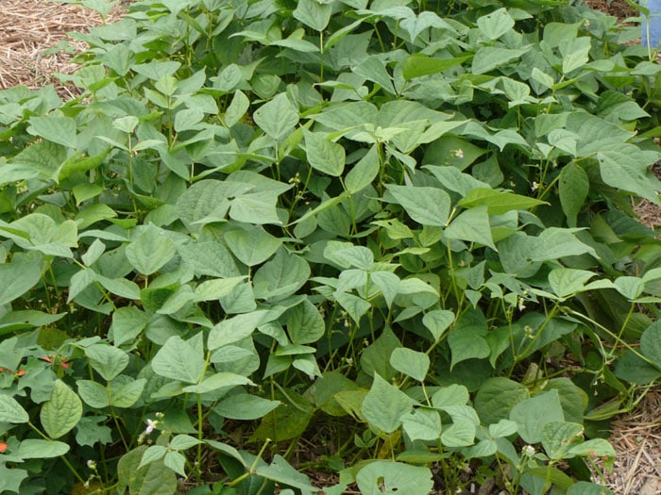
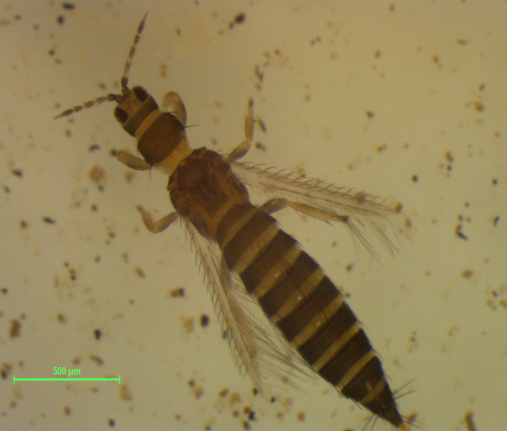
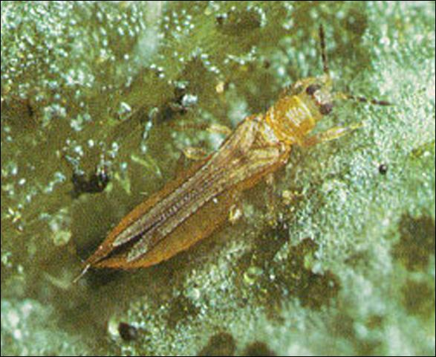
Fig. 1. Control of thrips on snap bean treated with various insecticides
Treatments Rate/acre
PFR 97 2lb
PFR 97 1 qt
Bote Coma 1 qt
Bote Optima 1 qt
Bote 22% 1 lb.
Bote 22% 2 lb.
Bote Optima-Nm 1 qt
Radiant 8 oz.
Radiant+Nm 8 oz.
Plinazolin 1.53 oz
Plinazolin 2.05
Torac 21 oz.
Control
No. thrips
Insecticide treatments

Slide 3
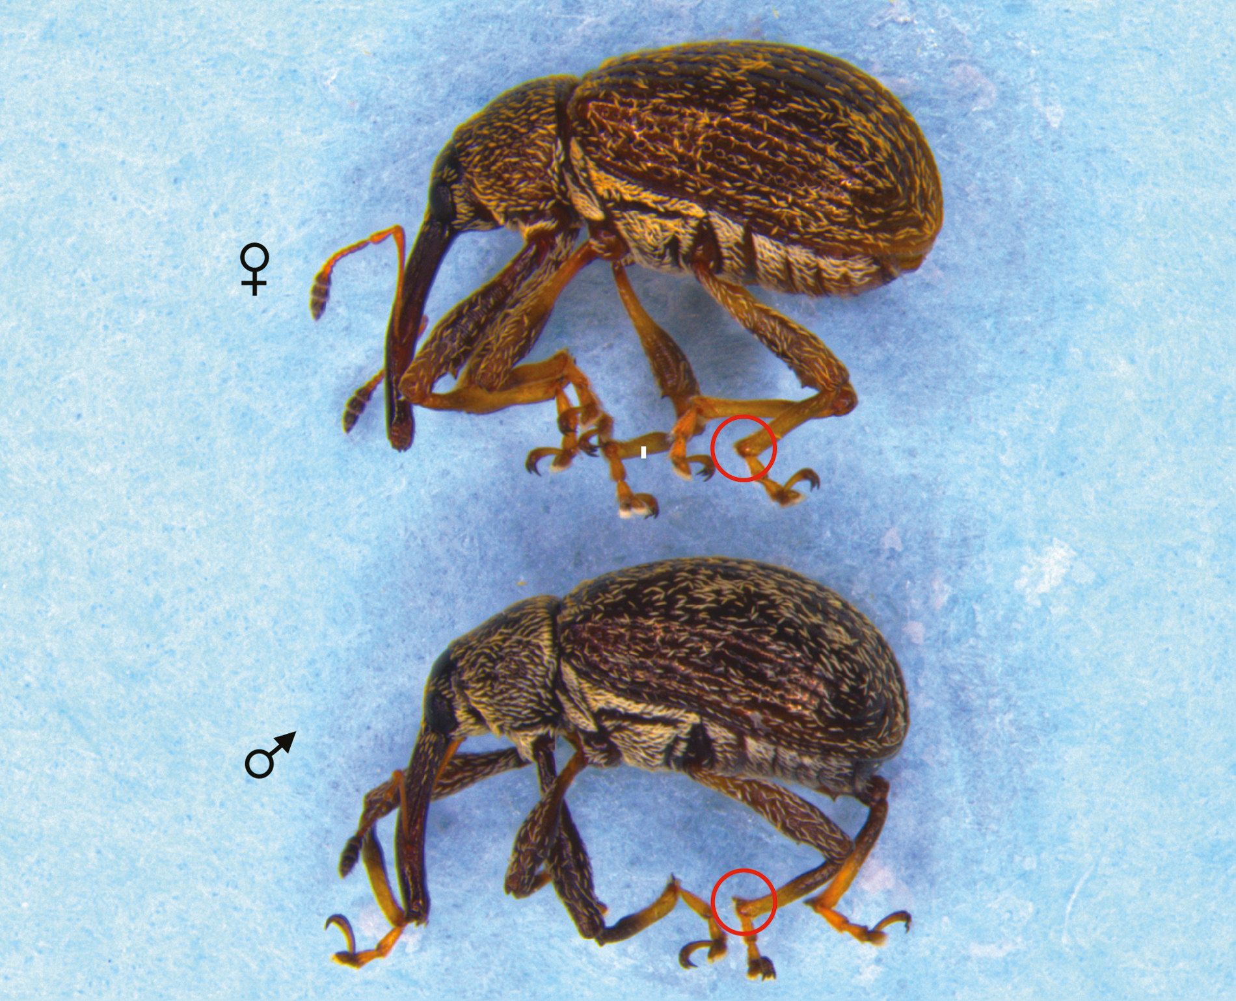
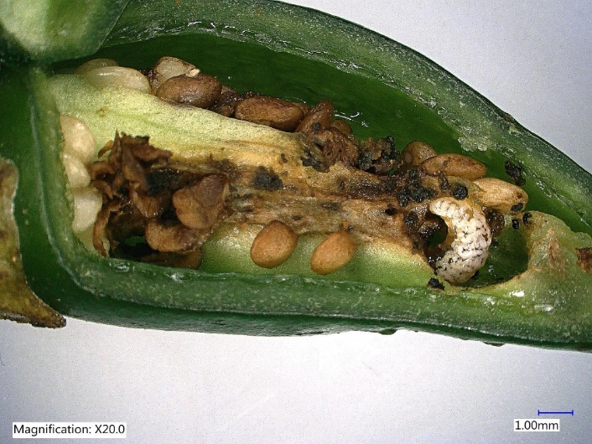
Fig. 2. Percentages of total infested and marketable pepper fruits in different cultivars
Percentage
Cultivars
Various cultivars used in the present study and their demographic profile
CULTIVAR | FRUIT SIZE (INCHES) | PLANT HEIGHT (INCHES) | SHU | Type
Bell pepper | 2-5 (D), 2-6 (L) | 10-12(L), 4-6(W) | 0 | Perennial
Jalapeño | 2-3 (L) | 12-16 (L), 12-13(W) | 2500-8000 | Perennial
Habanero | 0.8-2.5 (L) | 10-12 (L), 7-9(W) | 100,000-350,000 | Perennial
Ghost pepper | 2-3 (L) | 4-7 (L), 9-11(W) | 1,000,000 | Perennial
Scorpion | 2-3 (L) | 12-14 (L), 11-13(W) | 2,000,000 | Perennial

Slide 4
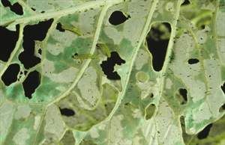
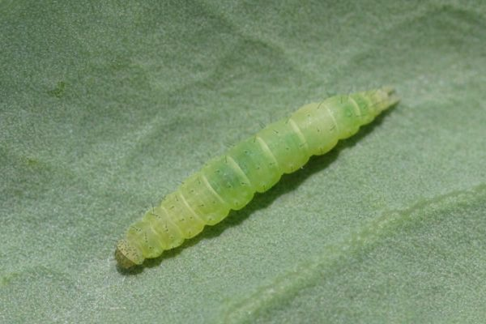
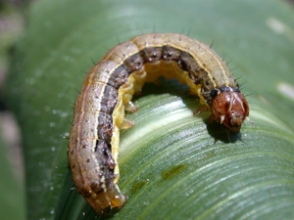
Fig. 3. Worm feeding damage (sq. cm.) on cabbage treated with various insecticides
1. Untreated control
2. MP-306 rotated
with Radiant
3. Radiant
4. MP-306
5. MP-306 + NF
Burkholderia rinojensis strain A396
Insecticide treatments

Slide 5
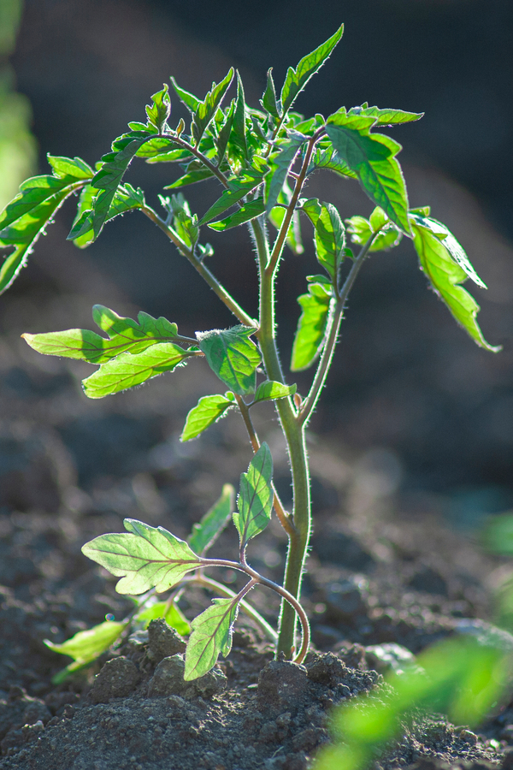
Fig. 4. Rating of `Sanibel’ tomato foliage treated with various insecticide treatments
Treatment Rate/acre
M-306 + 20 oz
NuFilm 0.25%
M-306 20 oz
M-306 rot 30 oz
Sivanto 14 oz
VCP-031 30 oz
Sivanto
Untreated
Rating on a scale 1-5

Slide 6
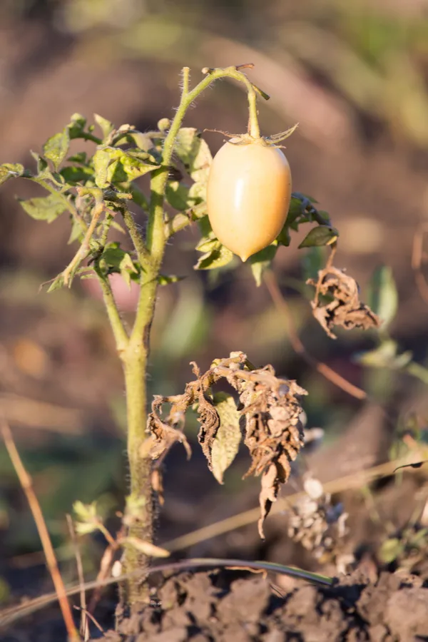
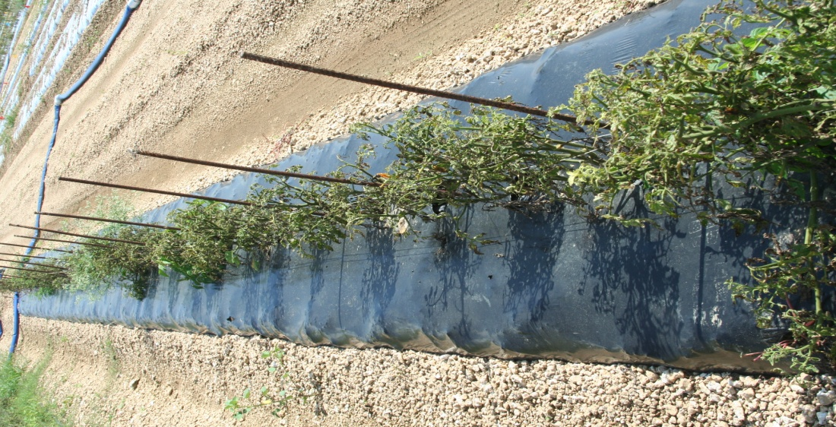
Fig. 5. Total number of TCSV symptomatic tomato plants/ plot treated with various insecticides
Treatment Rate/acre
M-306 + 20 oz
NuFilm 0.25%
M-306 20 oz
M-306 rot 30 oz
Sivanto 14 oz
VCP-031 30 oz
Sivanto 14 oz
Untreated

Slide 7
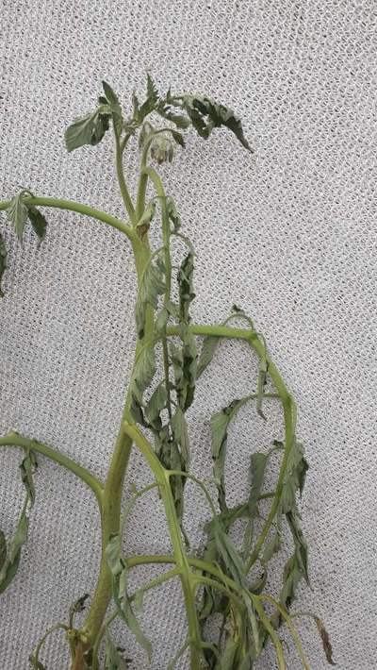
Fig. 6. Total number of dead tomato plants in various insecticide treated plots
Treatment Rate/acre
M-306 + 20 oz
NuFilm 0.25%
M-306 20 oz
M-306 rot 30 oz
Sivanto 14 oz
VCP-031 30 oz
Sivanto
Untreated
Number plants
Insecticide treatments

Slide 8
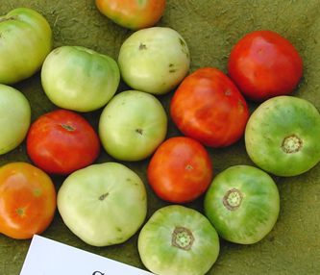
Fig. 7. Total number of fruits/tomato plot treated with various insecticides
Treatment Rate/acre
M-306 + 20 oz
NuFilm 0.25%
M-306 20 oz
M-306 rot 30 oz
Sivanto 14 oz
VCP-031 30 oz
Sivanto 14 oz.
Untreated

Slide 9
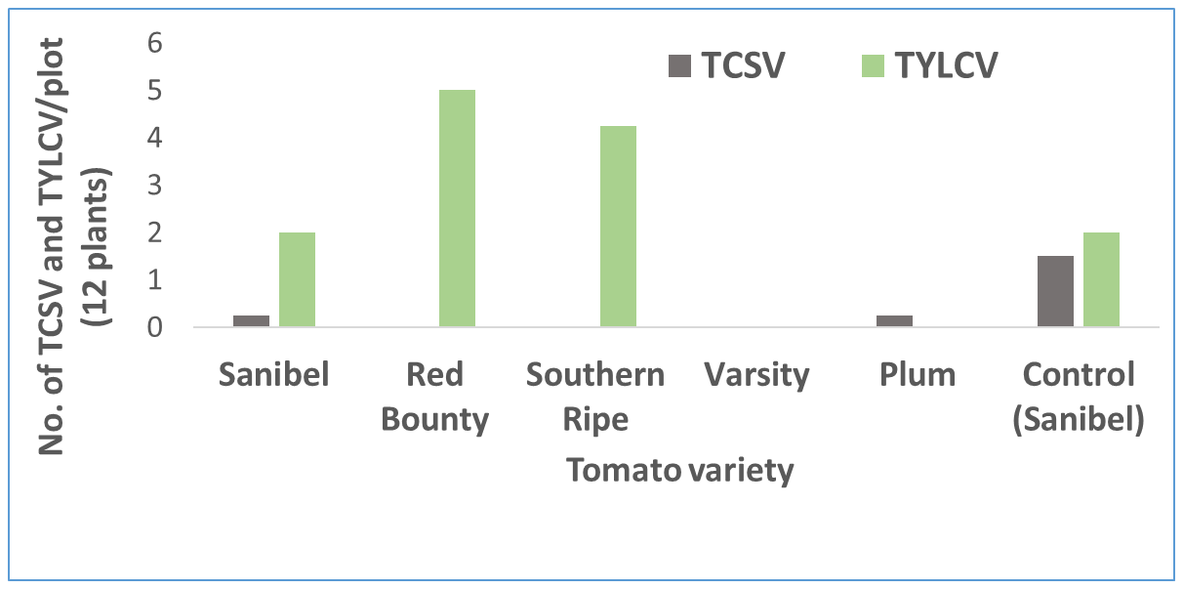
Fig. 8. TCSV and tomato varieties

